Slide 1

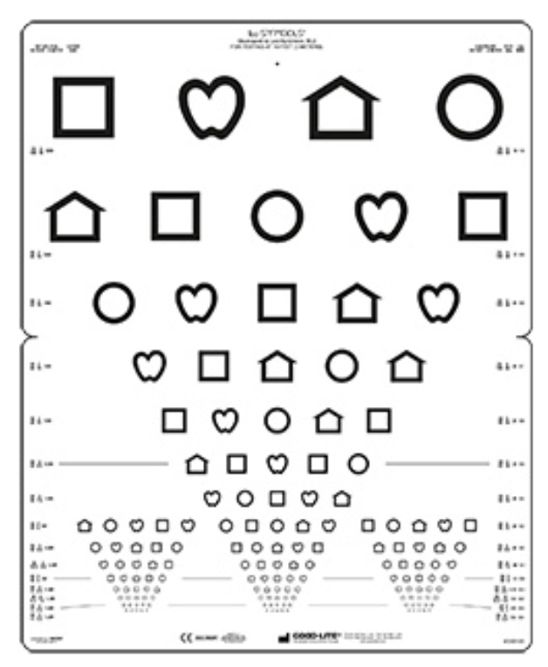
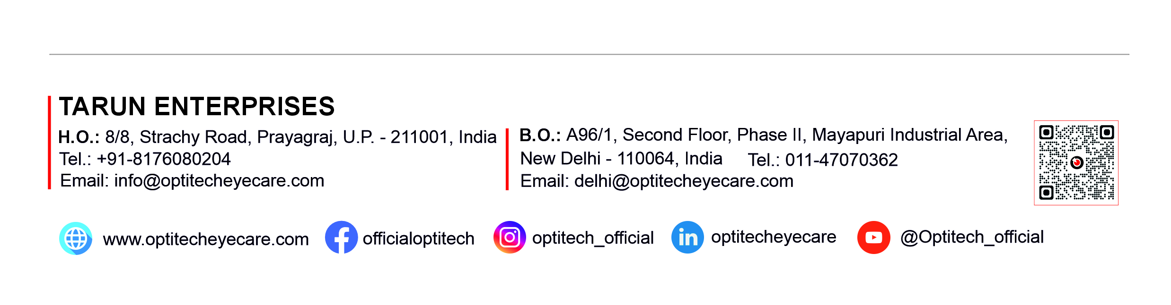
Lea symbol chart
Standardized pediatric vision testing chart
Includes universal LEA symbols (Apple, House, Circle, Square)
High-contrast black & white design for accurate results
Suitable for children and non-verbal patients
Durable, easy-to-clean material
Available in wall-mounted and handheld formats

